Slide 1



When: Periods
Introduction to DHIS2

Slide 2



Introduction
“When”
Period
Notes:
In the+ last video of the series about building blocks in DHIS2 we will discuss the +“when” dimension, the+ “period”.

Slide 3

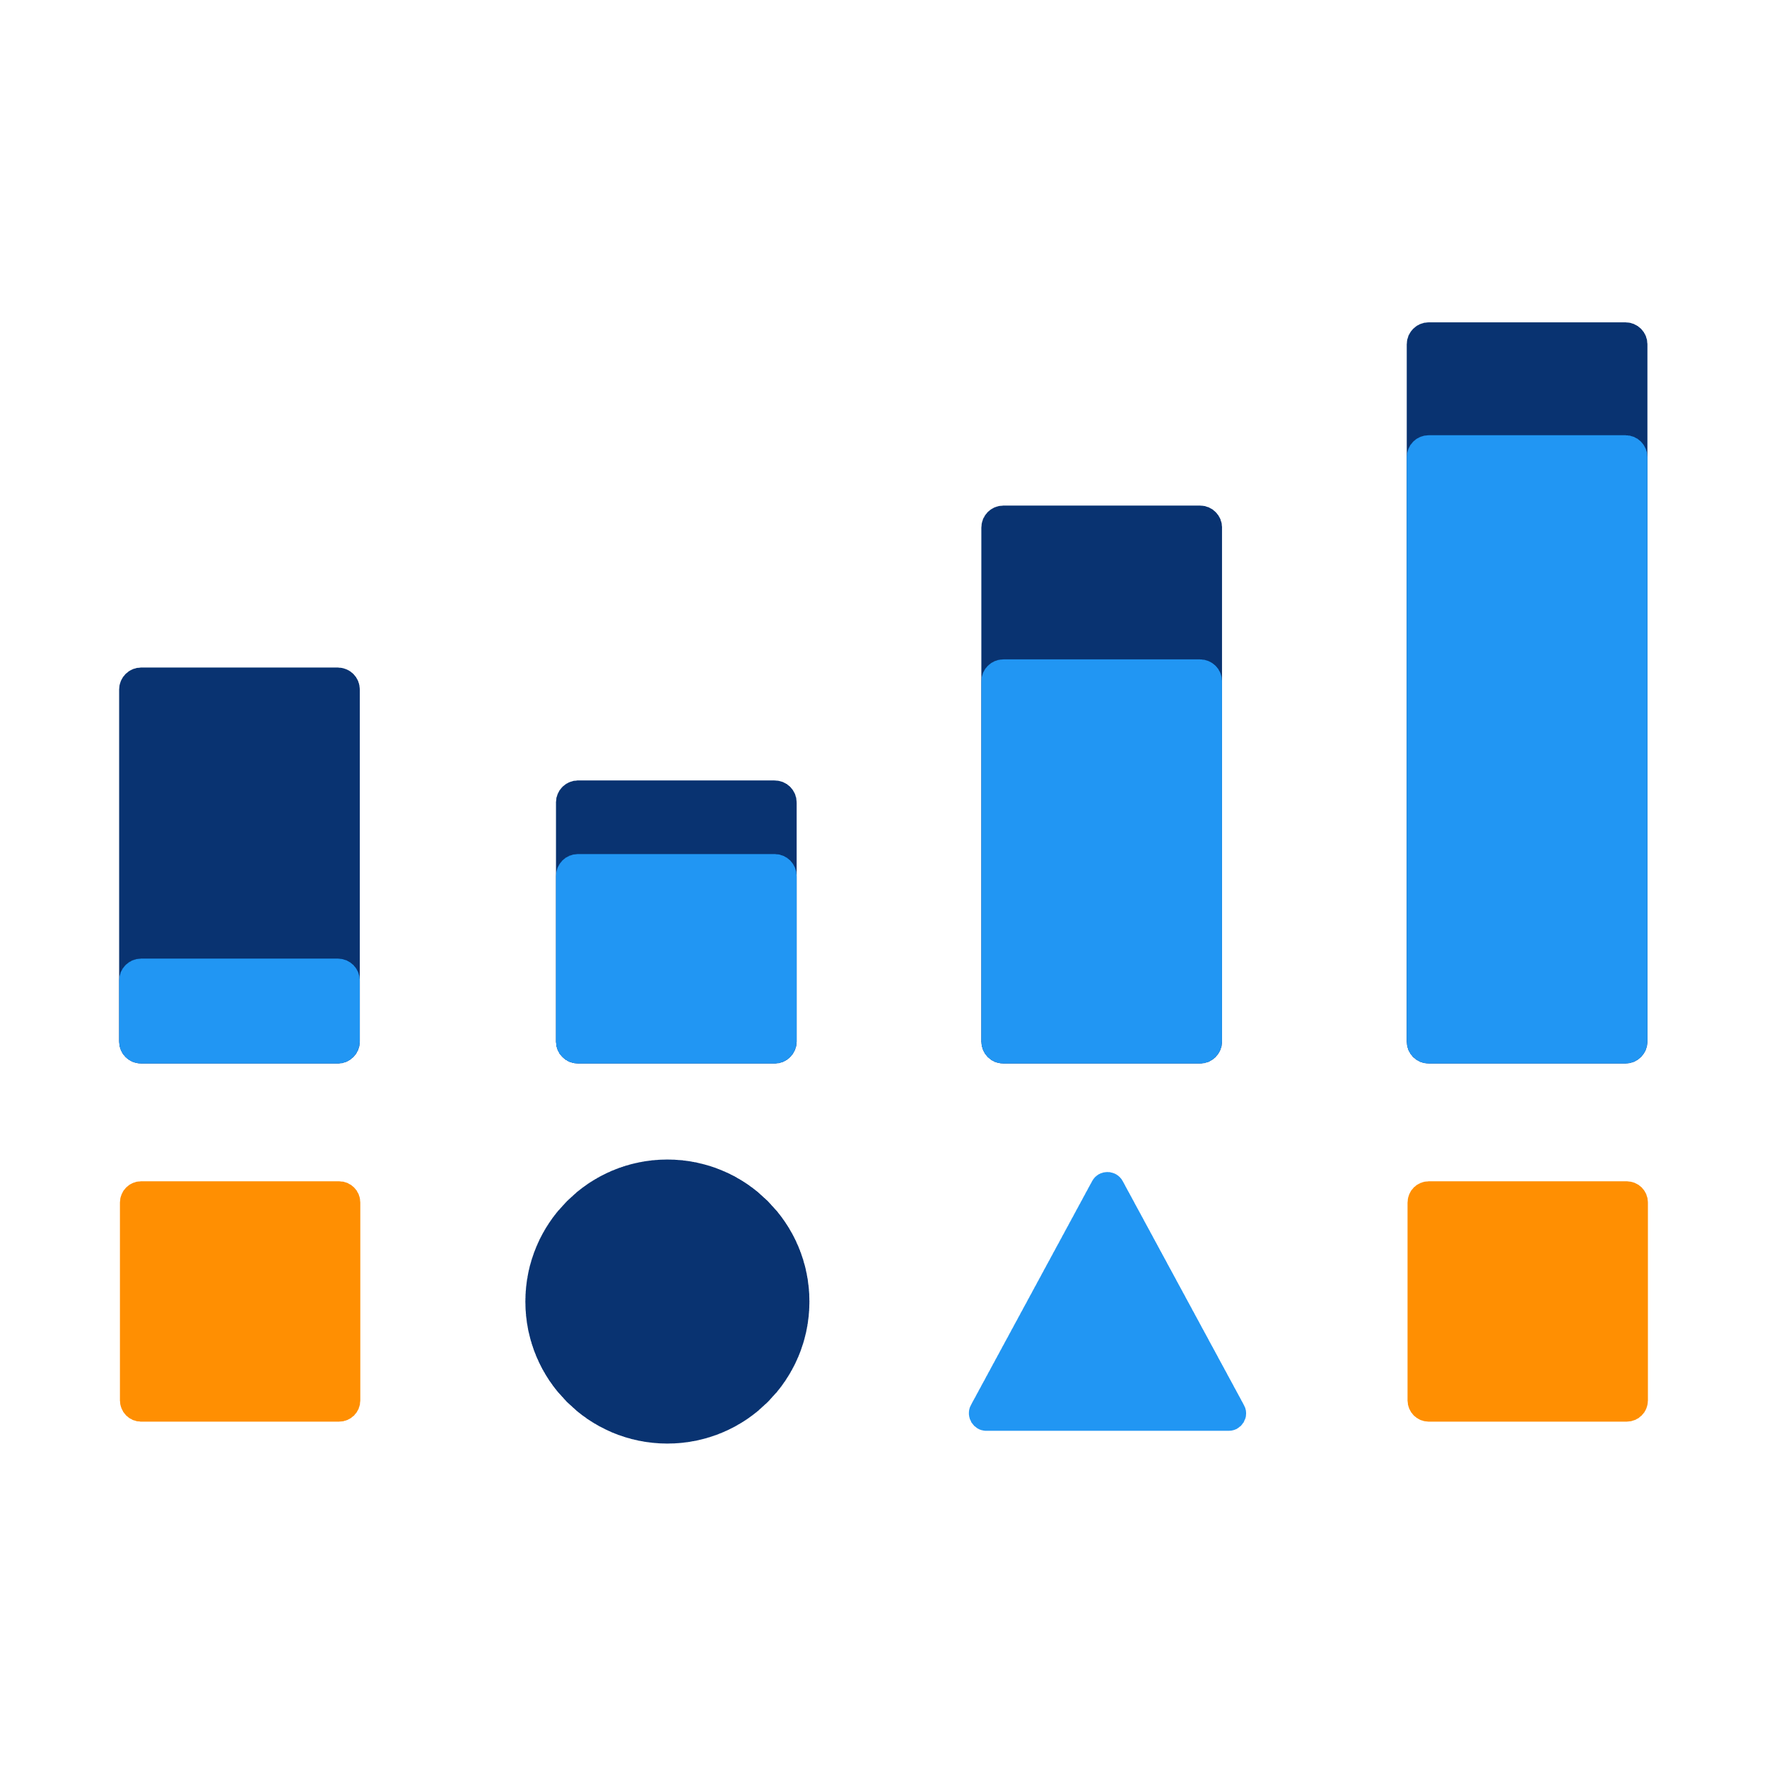
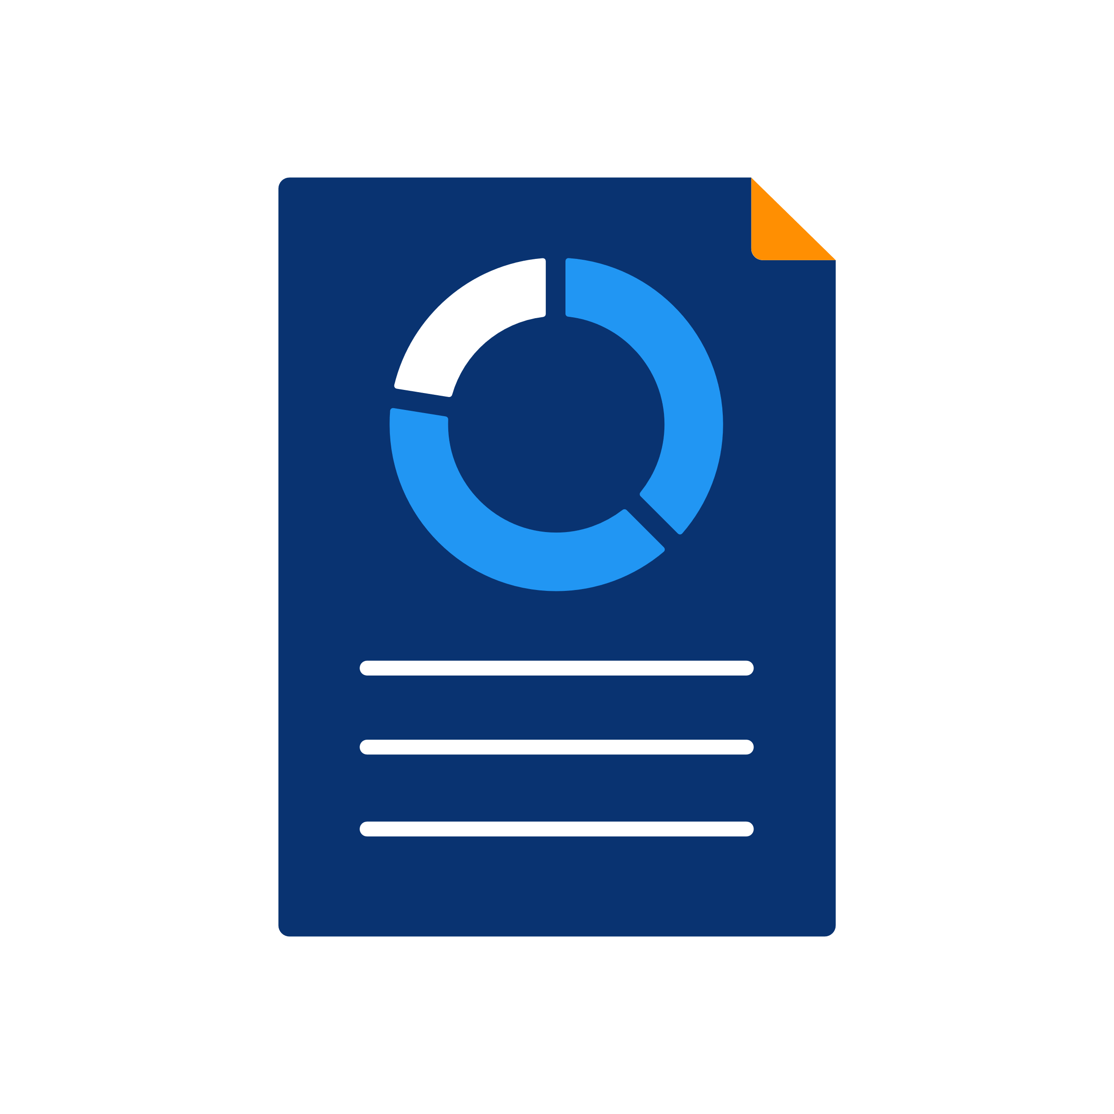
The use of periods
“When”
Collecting data
Analyzing data
Period
Creating periodic reports
Notes:
The period is a significant factor+ when you are + collecting data, +analysing data over time or when +creating periodic reports, such as monthly, quarterly or annual aggregated reports.

Slide 4
Example of periods for data collection
“What”
“Where”
“When”
Positive Malaria Cases
Namchala Health Center
October 2020
Notes:
Let's revisit our example of +New cases of Malaria reported in +Namchala Health Center. We see that those cases were reported for the period of +October 2020. That is a very simple example of a period for aggregate data collection.

Slide 5
Example of periods for data analysis
Month-to-month
Annual
+
+
October 2020
Notes:
In the context of data analysis in DHIS2,periods +can be combined in many ways, and how you use them depends very much on the type of insight you are looking for. You can get aggregated numbers for a specific period, +such as October 2020, +month-to-month trend, or +annual trend.

Slide 6

Example of periods for data analysis
Monthly
Last year
Jun
Aug
Feb
Apr
Jul
Sep
Oct
Mar
Nov
Jan
Dec
Notes:
For example, we might be interested in +Malaria data for this +facility displayed +monthly for the +last year +to++ analyse trends

Slide 7
Example of periods for data analysis
Yearly
2016-2020
2019
2018
2016
2020
2017
Notes:
or perhaps we are concerned about +yearly aggregate Malaria data for the period of 2016-2020.

Slide 8
Example of periods for data analysis
Yearly
2016-2020
Monthly
Last year
Notes:
“yearly, 2016-2020” and +“Monthly, last year” are both examples of periods in DHIS2.

Slide 9
Example of periods for data analysis
Monthly
Frequency
Yearly
Last year
Time frame
2016-2020
Notes:
Notice that the first part (+“yearly”, “monthly”) refers to the +frequency you would like to display the data for. The second part +(last year, 2016-2020) refers to the +overall time frame for which you would like to aggregate the data.

Slide 10
Example of periods for data analysis
Weekly
Last month
Monthly
Last year
+
Frequency
Time frame
Quarterly
2016-2020
Yearly
Last 5 years
Notes:
For data analysis in DHIS2, any period in DHIS2 will be some +combination of those two components, frequency and time frame.

Slide 11
Relationship between periods for data collection and analysis
Aggregate data
Reports
Periods available for analysis depend on:
Weekly
When data are collected
Monthly
The reporting schedule of a program
Quarterly
Can be configured for each data element
Annual
Notes:
For +aggregate data, the +periods available for you to analyze your data are dependent upon the predefined +period in which your data are collected. This depends on the +reporting schedule of a given health program, which +may call for +weekly…+ +monthly… ++quarterly…+ or +annual reports, among others. These periods +can be configured for each data element collected.

Slide 12


Example of periods of data collection and data analysis of malaria new cases
Data analysis
Yearly
6-monthly
Weekly
Quarterly
Monthly
Jan
Feb
Mar
Apr
May
Jun
Jul
Aug
Sep
Oct
Nov
Dec
Data collection
Notes:
For example, if the +data element new malaria cases is +collected monthly, we can display this data for +each month +it is collected or we can sum this +data to +show it by +quarter, ++6-monthly or+ +yearly. We would not be able+ to show this monthly data by +week however, as the lowest level of collection is by month, so it cannot be disaggregated any further.

Slide 13
Fixed and relative periods
Fixed period
Relative period
Specific and defined period of time
2016-2020
Oct 2020
2016
2017
2018
2019
2020
Notes:
DHIS2 supports two +period types when analyzing or reviewing your data, including fixed and relative periods
+October 2020 or the years +2016-2020 are examples of fixed periods, meaning they refer to a +specific and defined period of time.

Slide 14
Fixed and relative periods
Fixed period
Relative period
Specific and defined period of time
Defined in relation to the date the analysis is carried out
2016-2020
Last year
Oct 2020
Last month
This quarter
Notes:
DHIS2 also supports relative periods such as +“last year”, +“last month” and +“this quarter,” which are +defined in relation to the date the analysis is carried out.

Slide 15
Fixed and relative periods
In year 2021
=
Fixed period
Relative period
Year 2020
Last year
Jan – Dec 2020
Does not update automatically over time
Automatically updates with new data over time
Notes:
In some cases fixed and relative periods both refer to +the same period of time, for example if the +current year is in 2021, then the fixed period +“year 2020” and the relative period +“last year” both +refer to the same period. The key difference is that a fixed period +does not update automatically over time for an analysis item; whereas a relative period will +automatically update with new data over time in relation to the real world date. When creating analytical resources within DHIS2 it is possible to make use of this functionality.

Slide 16

The use of relative periods
January
Last month
February
March
Monthly report that can be reused
Notes:
Relative periods can be +useful if you, for instance, want to design a +monthly report that can be reused +every month without having to+ manually change the report to reset the+ period to the+ correct month.

Slide 17
Summary
Period
Time dimension in DHIS2
Frequency
+ time frame
Data collection
Data analysis
Fixed period
Fixed period
Relative period
Does not update automatically over time
Automatically updates with new data over time
Notes:
In summary, we learned that the +“period” is the +time dimension in DHIS2 for both +data collection and +data analysis.
Periods within DHIS2 consist of a combination of +frequency (such as monthly, yearly..) and +time frame (for example 2020, 2016-2020, Last six months).
The +set frequency of the data collected defines the +lowest level of period detail of the Data analysis
While aggregate data capture uses +only fixed periods, in data analysis, two types of periods are used, +fixed and +relative. Unlike fixed periods which +do not update automatically over time, relative periods will +update automatically over time based on the current date of analysis.

